Slide 1

Drowsiness Detection System for Truck Drivers

Slide 2
Group Members
Abhijeet Chaudhari
Harshilkumar Patel
Kishankumar Patel
Rishav Rana

Slide 3
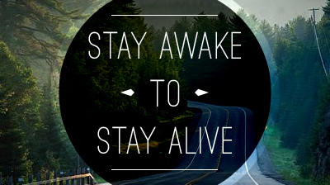
Motivation

Slide 4
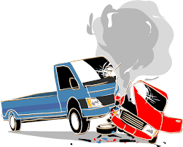

National Collision Data Of Truck (1999-2020)
1999
2020
Accidents
Causalities
Injuries
325,907
3,027
157,222

Slide 5
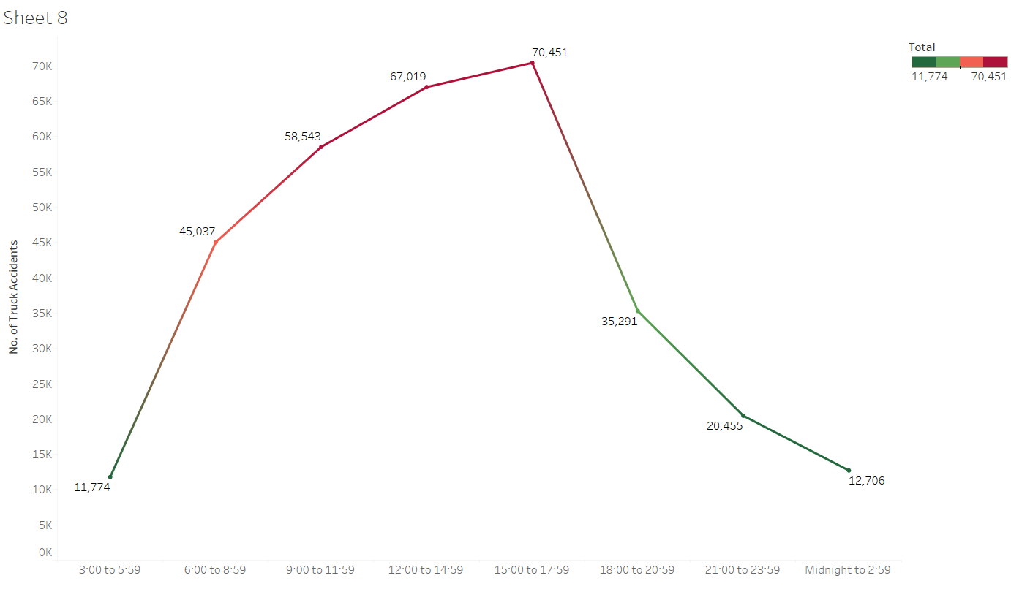
Hourly Analysis of Truck Accidents from 1999 - 2020

Slide 6
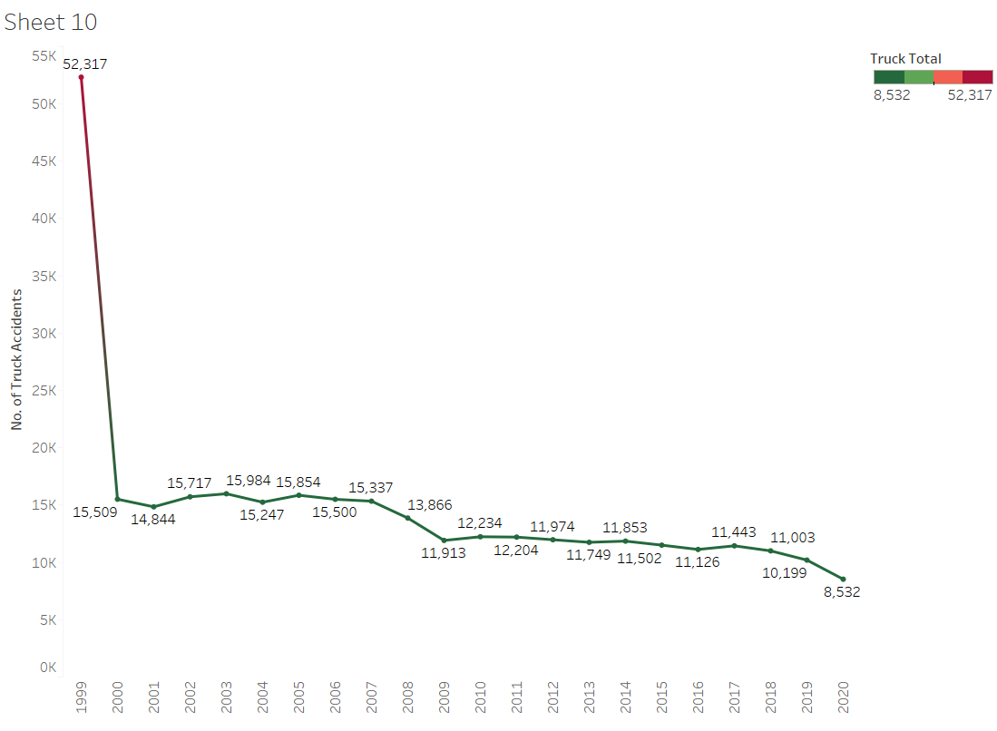
Yearly Analysis of Truck Accidents from 1999 - 2020

Slide 7
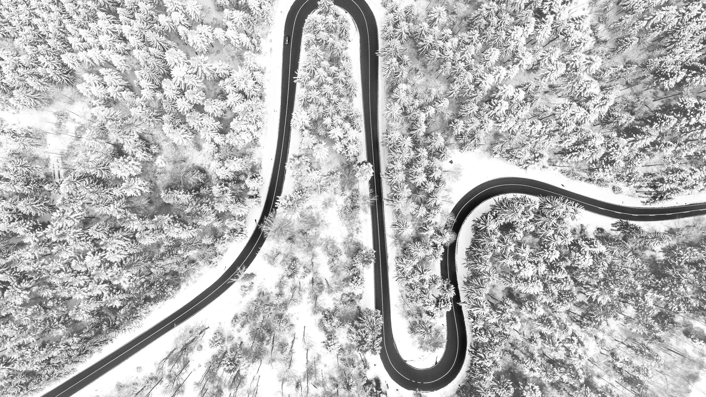
RoadMap

Slide 8
Conducted a comprehensive literature review.
Gathered feedback and made necessary changes.
Developed a robust algorithm.
Data Annotation & Model Training
Methodology
Results
Research & Data Collection
Algorithm Development
Testing
Assessed various drowsiness detection technologies.
Created a labeled dataset for accessing results.
Continuously upgrading the algorithm and system.

Slide 9

Data Collection

Slide 10
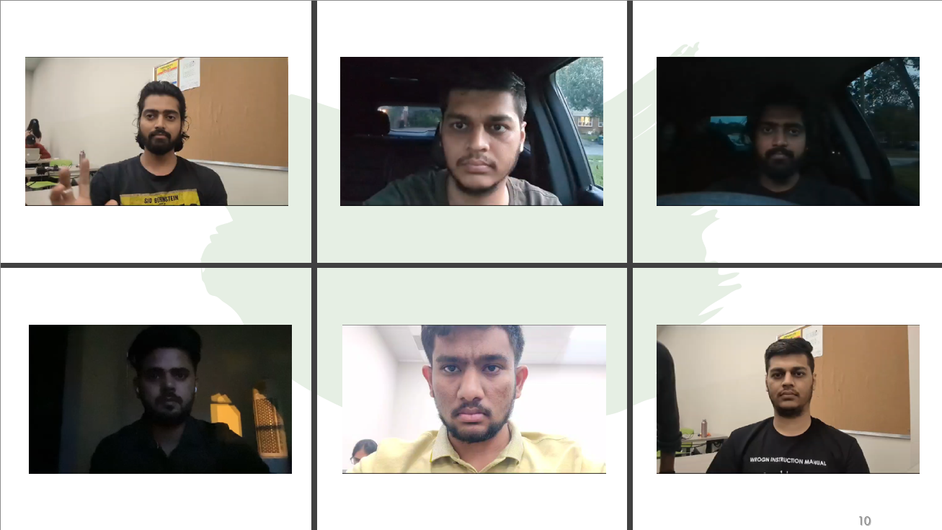

Slide 11

Methodologies

Slide 12
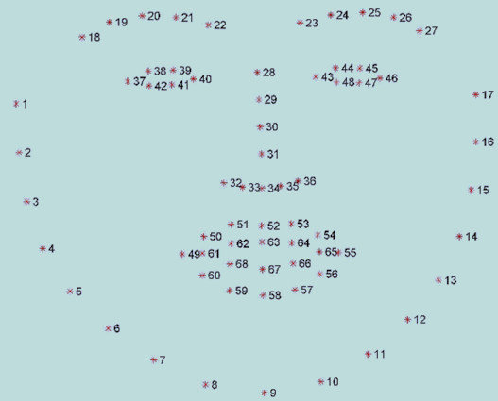
Dlib and Open CV

Slide 13
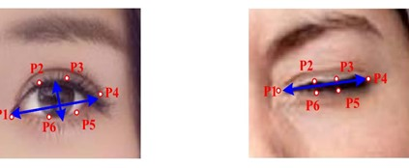
Eye Aspect Ratio (EAR)

Slide 14
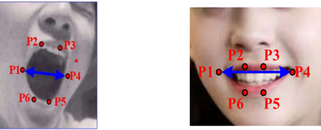
Mouth Aspect Ratio (MAR)

Slide 15
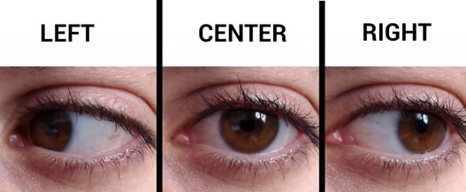
Gaze Ratio

Slide 16
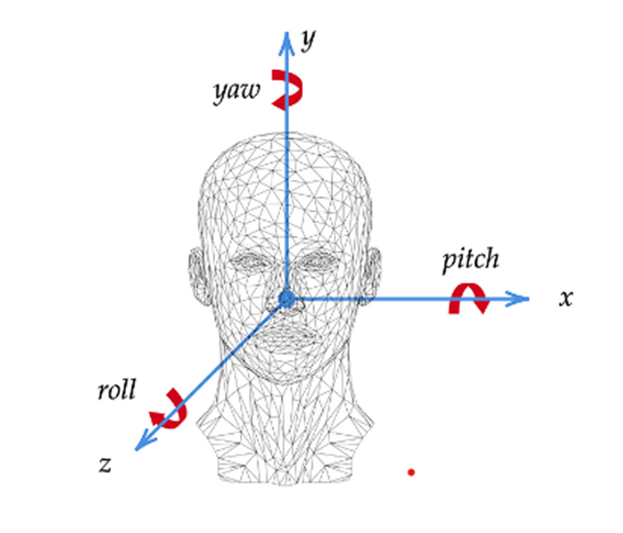
Node Detection

Slide 17
Data Annotation & Model Training

Slide 18
Initialize the Model
Capture Video Input
Preprocess Data
Extract Features
EAR Calculation
MAR Calculation
Nodding Detection
Gaze Ratio Detection
No
No
No
No
No
No
No
No
No
> 0.28
> 0.18 and <= 0.28
< 0.18
< 0.75
Angle < 3 and
Frames < 45
< = 0.75 and Frames =< 45
> 0.75 and < 0.21
> = 0.21 and Frames =< 45
Yes
Yes
Yes
Yes
Yes
Yes
Yes
Yes
Status - Active
Status - Drowsy
Status - Eyes Closed
Status - Yawning
Status - Nodding!
Status - Gazing Left
Status – Gazing Forward
Status - Eyes Closed
>= 80 Frames
>= 40 Frames
> = 45 Frames
>= 45 Frames
>= 45 Frames
Yes
Yes
Yes
Yes
Yes
Status – Drowsy! Wake UP!!
Status – Sleeping! Wake UP!!
Status –Nodding! Feeling Drowsy!!!!
Status – Distracted Looking Right!
Status – Distracted Looking Left!
Generate Alarm
Generate Alarm
Generate Alarm
Generate Alarm
Generate Alarm

Slide 19
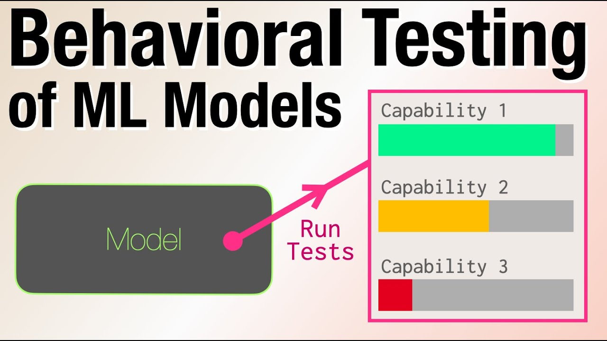
Testing

Slide 20
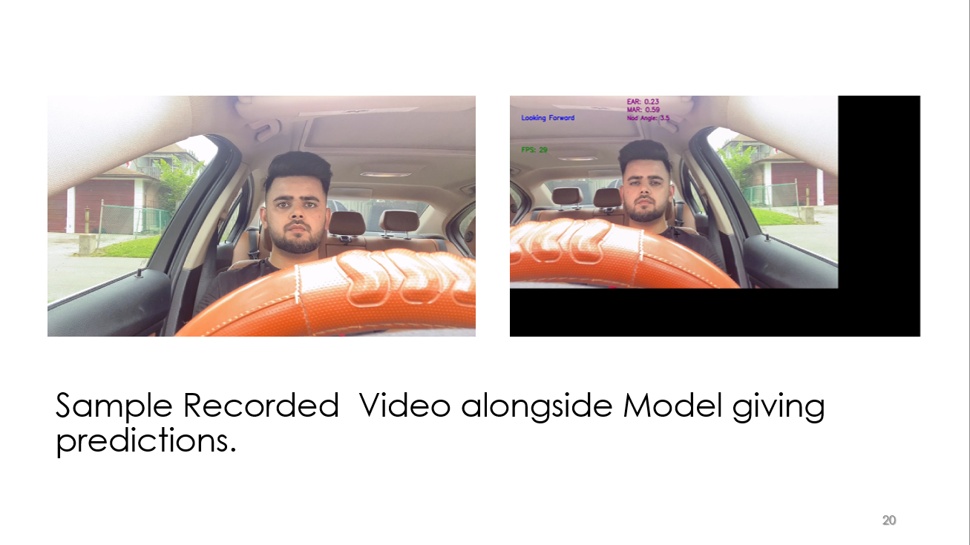

Slide 21
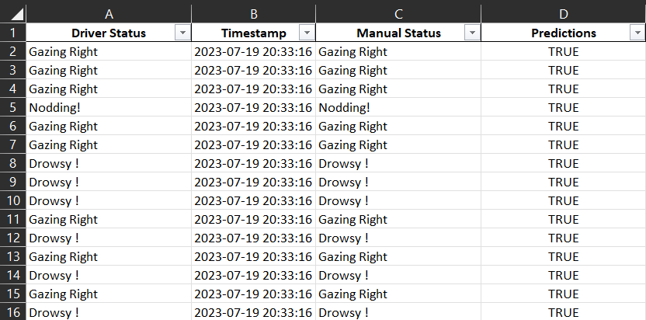
Driver Status checked manually and recorded.

Slide 22

Results

Slide 23

Day Light Detection

Slide 24

Percentage Distribution of Driver’s behavioral status out of 100%

Slide 25
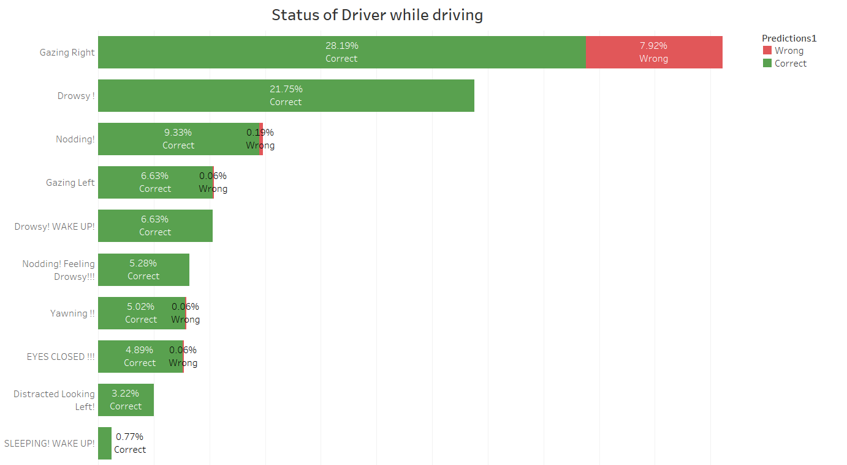

Slide 26
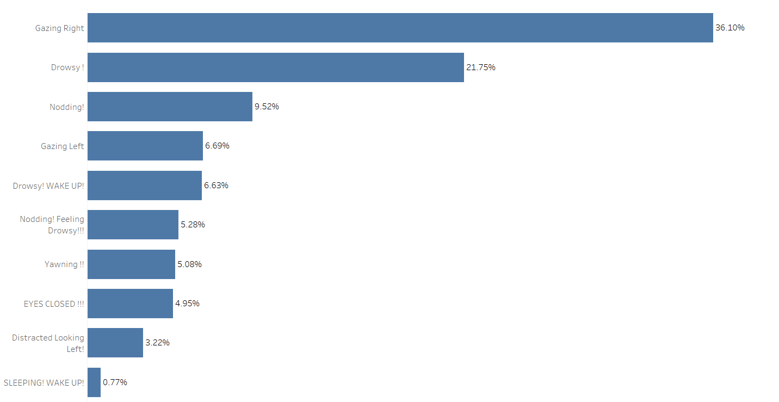

Slide 27


Slide 28
Percentage of Correct Detections of driver’s behavioral status​

Slide 29
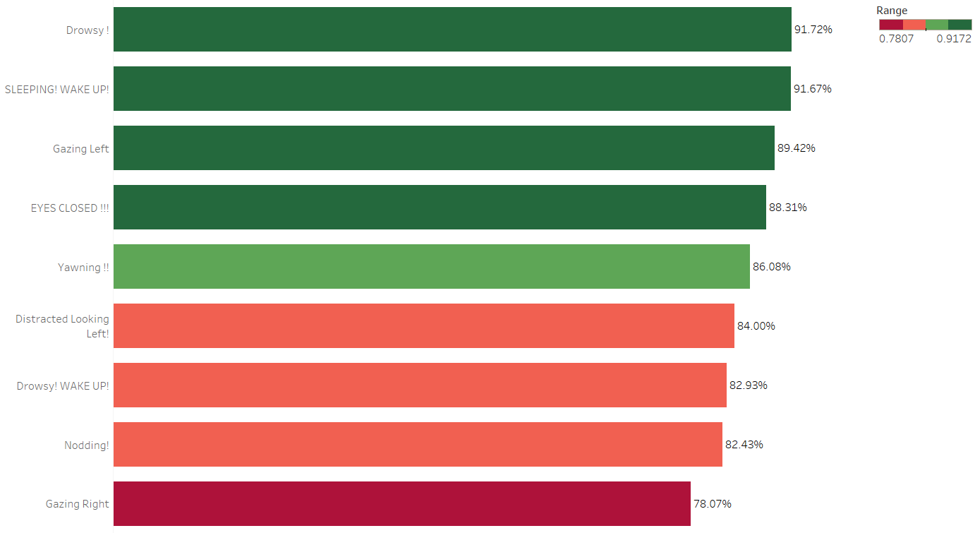

Slide 39

Low Light Detection

Slide 40
Percentage Distribution of Driver’s behavioral status out of 100%

Slide 41
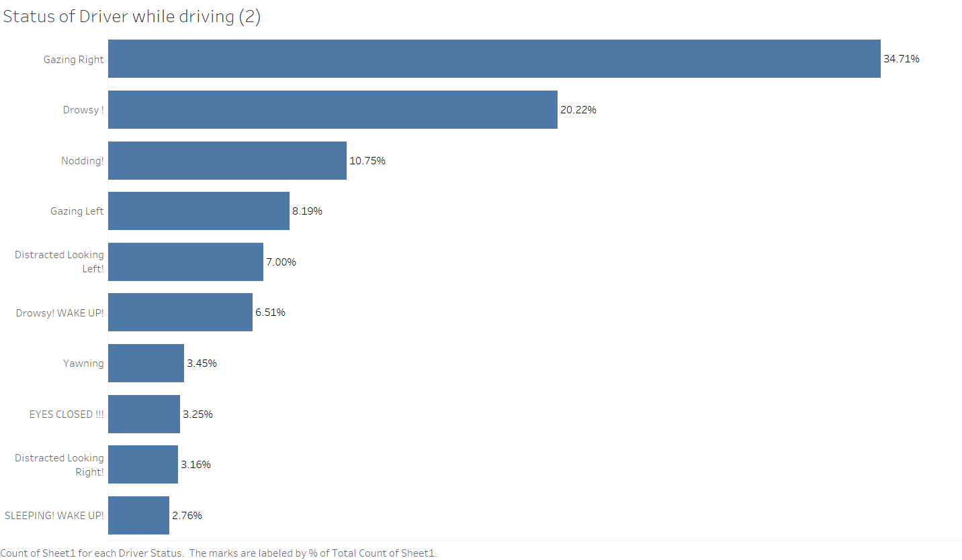


Slide 43
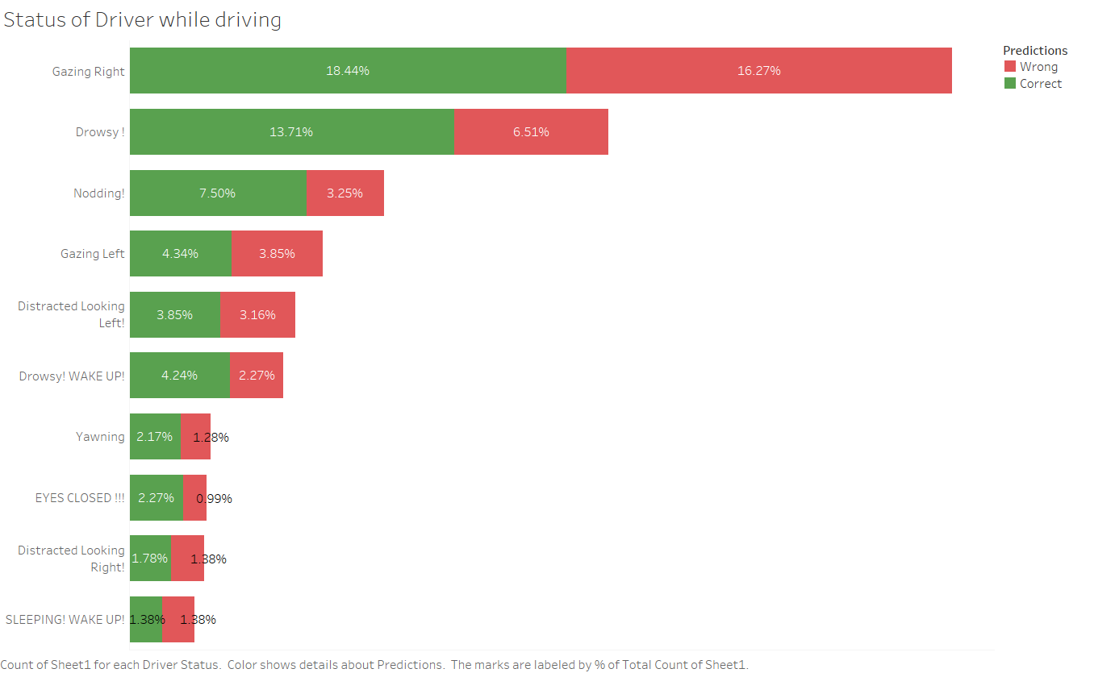

Slide 44
Percentage of Correct Detections of driver’s behavioral status​

Slide 45
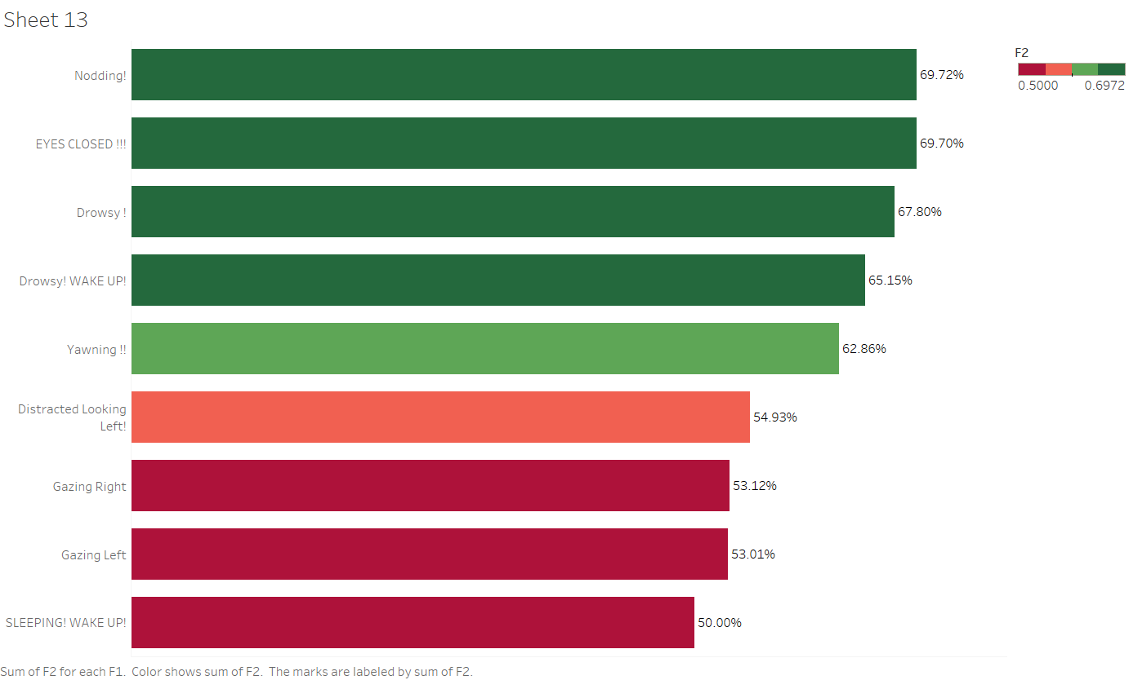

Slide 55

Comparing Detections
Day Light
vs
Low Light

Slide 56
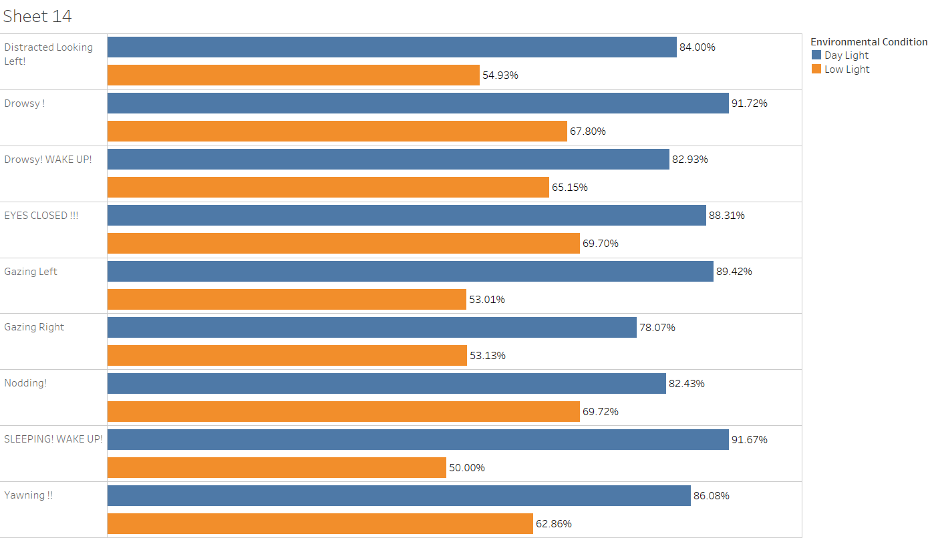

Slide 57

Limitations

Slide 58
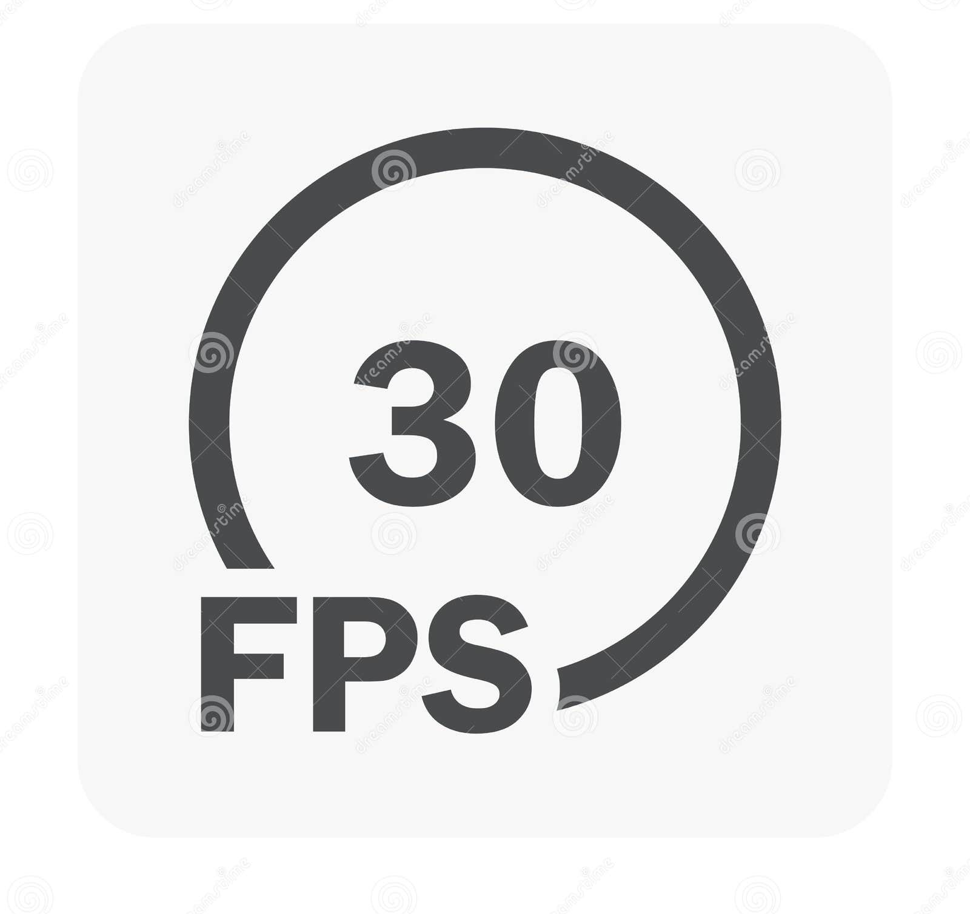



Slide 59

Future Work

Slide 60
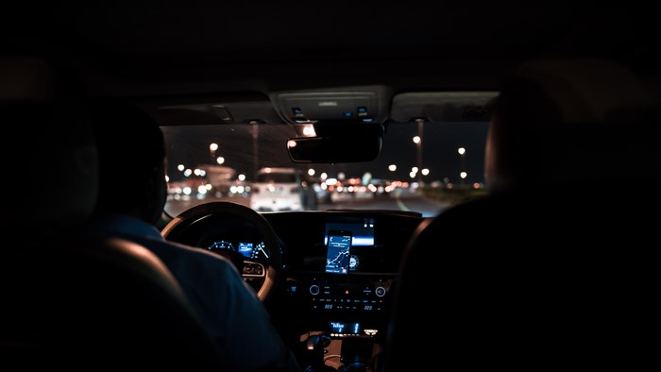

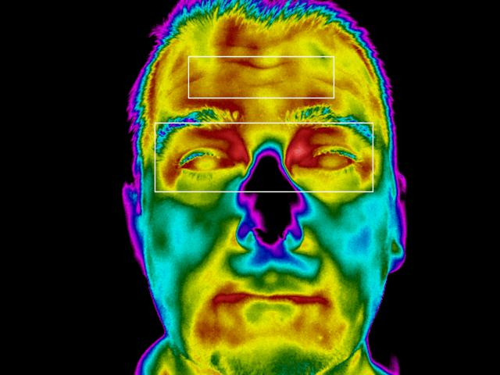

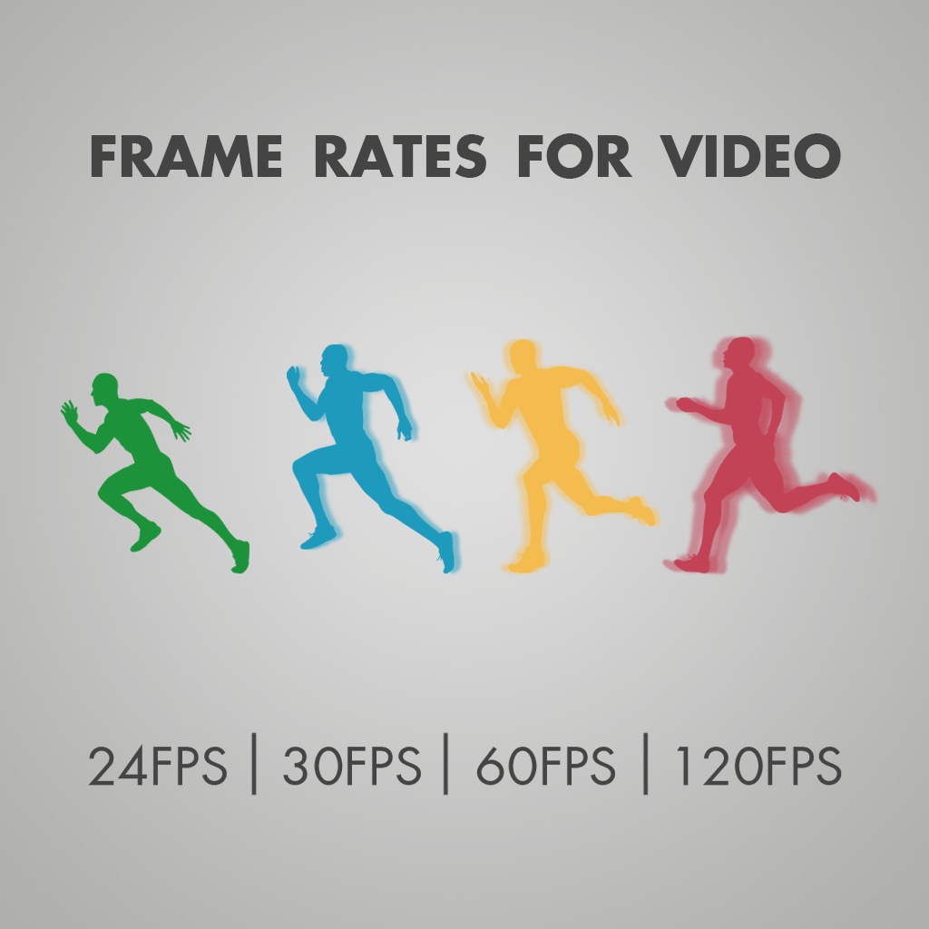
Robustness to Lighting Conditions
Reducing False Alarms
Eye Detection through Sunglasses using Infrared Sensors
Driver-Specific Adaptation
Generalizing the Model

Slide 61

https://github.com/RisshhavRana/Capstone-Project-Group-3

Slide 62

Thank you

